Slide 1
PublicPrompt – AI Chatbot for Public Queries Data Science & AI Bootcamp Project by Sana Hussain DS & AI – Cohort 11

Slide 2
agenda
Problem Statement 3
Project Overview 4
Key Features 5
Workflow / Architecture 6
Tech Stack & Deployment 7
Challenges & Learnings 6
Conclusion & Takeaways 11

Slide 3

Problem Statement
Citizens often have repetitive questions for Price Control & Commodity Management Department in Punjab PC&CMD.
Manual handling increases staff workload and response time.
Need: Automated, lightweight solution to handle FAQs efficiently.

Slide 4
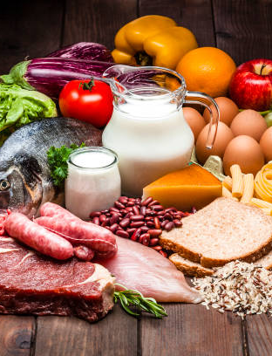
Project Overview AI-powered chatbot with predefined intents.
Handles common queries:
Office hours
Contact info
Commodity INFO
Service procedures
Optional OpenAI API integration for unknown queries.

Slide 5

Project Overview
I created a local AI-powered chatbot for PCCMD that uses embeddings + similarity search on a curated knowledge base, and runs in a Streamlit web app for easy interaction.

Slide 6
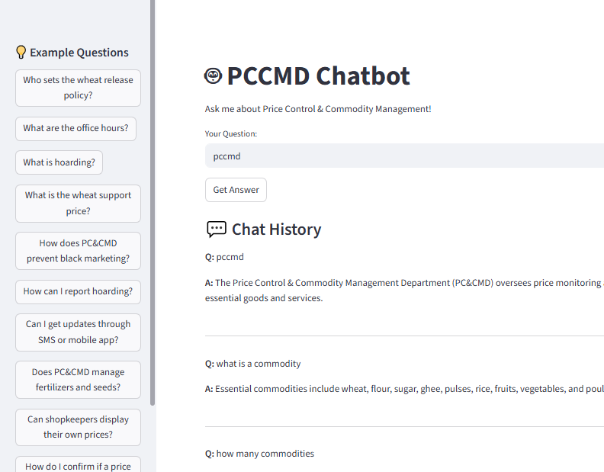
Technical Overview Problem: Static FAQs in JSON are hard to search and not user-friendly.
Solution: Built a chatbot that turns JSON Q&A into a smart assistant.
Core Features:
RAG pipeline with LangChain + FAISS
Open-source LLM (no API keys, no downloads)
Retrieves answers for both short & long queries
Session memory with reverse chat history
Workflow: JSON → Embeddings → Vector DB → LLM → Chat Response
Deployment: Streamlit app, lightweight, runs locally or on cloud.

Slide 7
Key Features
Text-based chat interface
Sample prompt for easy use
Latest messages appear at the top (chat-like view)
Lightweight and deployable online via Streamlit
Expandable for future queries

Slide 8
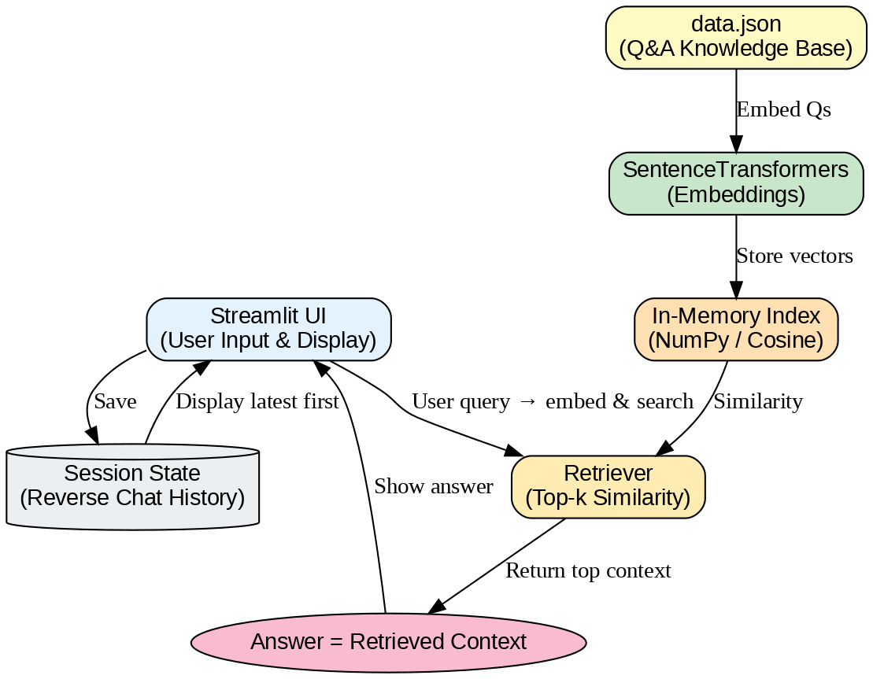
Workflow / Architecture

Slide 9
Workflow / Architecture
LangChain is the framework connecting everything:
Data ingestion (loading your data.json)
Embedding + vector storage (FAISS)
Retriever (fetching the most relevant Q&As)
LLMChain (wrapping the small LLM to generate answers)
Memory (to save chat history per session — “reverse saved chat” feature).

Slide 10
Demo
Add screenshots of your chatbot in action
Highlight:
Typing a question
Clicking a sample prompt
Receiving a response

Slide 11
Tech Stack & Deployment
Backend
Python 3.10+
FastAPI (REST API)
LangChain (RAG pipeline)
Hugging Face Transformers (models & embeddings)
FAISS (vector database for retrieval)
Hosted on Streamlit Cloud
Public URL available
Lightweight, no installation required
Accessible from any browser

Slide 12

Challenges & Learnings
Handling unknown queries
Designing a simple and user-friendly interface
Reversing chat messages for better UX
Integrating sample buttons for easier interaction

Slide 13

Conclusion / Takeaways
Reduces staff workload by automating FAQs
Improves citizen experience with quick responses
Scalable for additional government services

Slide 14
thank you
Sana hussain
sanahussain4747@gmail.com

